Slide 1
Automatic Lens Smear Detection
By:
Aditya Prakash Yaji

Slide 2
Content
Introduction
Problem Statement
Approach
Obtained Results
References

Slide 3
Introduction
Dirt and dust or smear on camera lenses is one of the important artifacts in digital imaging systems.
Dust or smear on the camera lenses caused by different reasons are not only an annoyance for photographers, but also a hindrance to computer vision and digital forensics.
It is important to preprocess the image to remove the smear.

Slide 4
What is Smear?
Smear will blur some areas in the picture, the defocus blur for lens dirties so large that the artifacts are always presented as a low frequency pattern in images.
Smear is almost fixed on camera, so the amount of scattered light is fixed since the integral of the outside illumination is unchanged.

Slide 5
Problem Statement
Input : Sequence of street view images
Output : A mask of the smear on the lens

Slide 6
Approach
To encounter this challenge, the steps followed has been listed.
Reading all the images of the dataset.
Resizing the image.
Converting to grayscale.
Improving contrast by histogram equalisation.
Obtaining average of all the images.
Converting grayscale to binary image.
Applying median filter to remove salt-pepper noise.
Detecting edges using Canny-edge detector.
Finding the contours of the edge-map.
Applying the Sobel filter.
Drawing the contours.
Saving and displaying the final output.

Slide 7
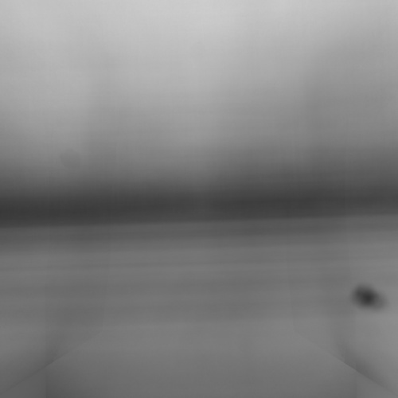
Obtained Results
For better understanding, the script is executed with limited images and we get the following as the intermediate and final outputs.
1. Averaged Image:

Slide 8

2. Thresholded Image:

Slide 9

2. Masked Image:

Slide 10
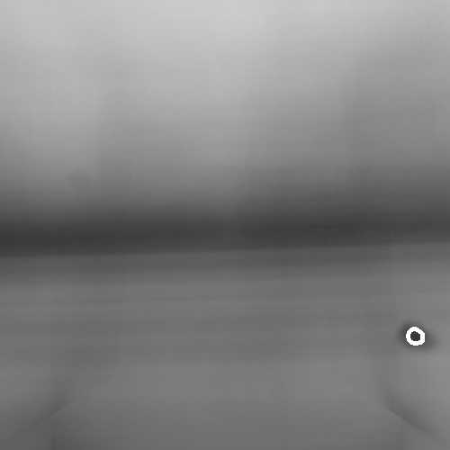
2. Smeared Image:

Slide 11
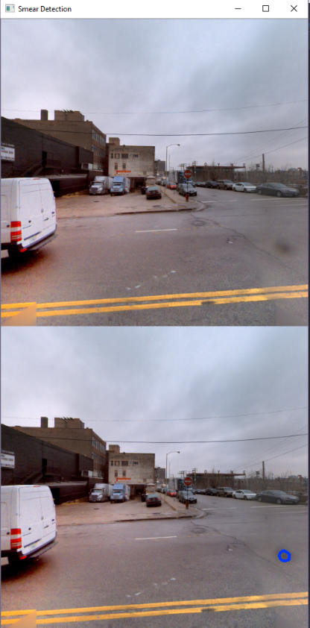
2. Final Result:

Slide 12
References
http://docs.opencv.org/trunk/da/d22/tutorial_py_canny.html
https://pythonprogramming.net/canny-edge-detection-gradients-python-opencv-tutorial/
http://docs.opencv.org/3.2.0/d4/d73/tutorial_py_contours_begin.html
http://miriamposner.com/classes/medimages/3-use-opencv-to-find-the-average-color-of-an-image/

